Slide 1

Plant Disease Detection
Industry / Inhouse Project
Review - I
Project Mentor : Dr. Mrs. Sujata Khedkar
Group Number : 10
Group Members :
Isha Desai
Jessica Lalchandani
Trishala Jeswani

Slide 2
Content
Introduction to Project
Lacuna in the existing systems
Problem Definition
Literature Survey
Methodology employed
ER Diagram
DFD Level 0, 1, 2
Hardware, Software, tools and the constraint.
Block Diagram
Modular Diagram
Next Work Plan
Conclusion
References

Slide 3
Introduction to Project
Agriculture is one of the main contributing sectors in the Indian economy. There are various issues hampering the growth of agricultural production in India.
Plant disease is one major problem among others.
The system proposes to aid the farmers in combating and taking quick actions to prevent losses due to disease proliferation.
The farmers can acquire quick analysis of the plant’s health by providing an image of the plant’s leaf.
The application provides facilities to interact in various regional languages in order to cater the needs of a vernacular audience.
A website and an android application are a part of the proposed solution in order to provide a user friendly interface.
Chatbot embedded in the application and the website will assist the farmers with their queries by providing multilingual support.

Slide 4
Lacuna in the existing system
There are many applications currently available in the market catering to the needs of the farmers.
But they do not provide the facility of interacting in different state languages.
There are many non-Hindi speaking states in India like West Bengal, Telangana, Tamil Nadu, Karnataka and Kerala.
Even farmers in states like Maharashtra would prefer to get the information in marathi.
Therefore it is the need of the hour to assist the farmers regarding the plant diseases, its causes and solutions in vernacular languages.

Slide 5
Problem Definition
Plant disease is one of the biggest challenges faced by the farmers of India.
The loss incurred each year due to the disease outbreak is huge and is increasing every year.
The information regarding the causes, symptoms and treatment of diseases will help the farmers to reduce the losses incurred. But this alone is not enough.
The identification of the disease type can be tricky and difficult for the farmers. To accelerate the treatment of the infested crops, an accurate and quick analysis of their state is required.
There are various applications in the market producing insights regarding the crop disease, but they are mostly taking inputs and giving outputs in English language.
The farmers from within the interiors of Indian villages need multilingual assistance in order to profit from the analysis.

Slide 6
Literature Survey
Sr. No. | Title | Summary | Citation
1. | A Survey on Chat-Bot system for Agriculture Domain. | The paper mainly focuses on two chatbots - “ADANS: An Agriculture Domain Question Answering System using Ontologies”, “AGRI-QAS Question-Answering System for Agriculture Domain”. ADANS uses a combination of Natural Language Processing(NLP) and semantic web technologies. AGRI-QAS focuses on processing unstructured data and provides responses for FACTOID queries such as ‘which’, ’what’, ‘who’, ‘where’. | P. Y. Niranjan, V. S. Rajpurohit and R. Malgi "A Survey on Chat-Bot system for Agriculture Domain," 2019 1st International Conference on Advances in Information Technology (ICAIT), Chikmagalur, India
2. | AgriBot - An intelligent interactive interface to assist farmers in agricultural activities. | In this paper, a chatbot is developed using Natural Language Processing technique.The algorithms used for prediction of the crops are K-nearest neighbour algorithm (Accuracy - 72.5%), Random forest (Accuracy - 78%), Decision Tree (Accuracy - 75%). The chatbot is designed using the DialogFlow API and if the chatbot fails to answer any query it is reassigned to the helpline centres. | D. Sawant, A. Jaiswal, J. Singh and P. Shah "AgriBot - An intelligent interactive interface to assist farmers in agricultural activities" 2019 IEEE Bombay Section Signature Conference (IBSSC), Mumbai, India

Slide 7
Literature Survey
Sr. No. | Title | Summary | Citation
3. | E-Agriculture for Direct Marketing of Food Crops Using Chatbots. | In this paper, a chatbot is developed to warrant fair price of the produce to the farmers and consumers. The chatbot is based on creating a secure chain for the communication of farmer and consumer without the mediation of any third person. It is developed using Python 2.7.9, R language, JavaScript and PostgreSQL. | U. Kiruthika, S. K. S. Raja, V. Balaji and C. J. Raman "E-Agriculture for Direct Marketing of Food Crops Using Chatbots," 2020 International Conference on Power, Energy, Control and Transmission Systems (ICPECTS), Chennai, India
4. | Plant Leaf Detection and Disease Recognition using Deep Learning. | In this paper, deep learning technique Convolutional neural network (CNN) is used for plant leaf recognition and disease detection. images as a basis for recognizing several types of plant diseases. This study provides an efficient solution for detecting diseases in apple, corn, grapes, potato, sugarcane, and tomato leaves. Certain data augmentation techniques are used such as rotating the images flipping and shifting of images horizontally and vertically. The final accuracy of the model is 96.5%. | S. V. Militante, B. D. Gerardo and N. V. Dionisio "Plant Leaf Detection and Disease Recognition using Deep Learning," 2019 IEEE Eurasia Conference on IOT, Communication and Engineering (ECICE), Yunlin, Taiwan

Slide 8
Literature Survey
Sr. No. | Title | Summary | Citation
5. | Smartphone Application for Deep Learning-Based Rice Plant Disease Detection. | In this paper, a deep learning based rice disease detection system is developed so that rice plant disease control can be carried out and the yield can be maximised. The smartphone application captures the images of the rice plant leaves and the classification gives the type of the disease. The performance of this system with VGG16 architecture has a train accuracy value of 100% and a test accuracy value of 60%. | H. Andrianto, Suhardi, A. Faizal and F. Armandika "Smartphone Application for Deep Learning-Based Rice Plant Disease Detection," 2020 International Conference on Information Technology Systems and Innovation (ICITSI), Bandung, Indonesia
6. | Detection of Banana Leaf and Fruit Diseases Using Neural Networks. | In this paper, ANN algorithm is used to detect the diseased banana fruit and its leaf. It is a multiclass classification and hence the accuracy for each class is different. The system takes input image of both the banana leaf and the banana fruit and predicts whether the plant is diseased or healthy. | N. Saranya, L. Pavithra, N. Kanthimathi, B. Ragavi and P. Sandhiyadevi "Detection of Banana Leaf and Fruit Diseases Using Neural Networks," 2020 Second International Conference on Inventive Research in Computing Applications (ICIRCA), Coimbatore, India

Slide 9
Literature Survey
Sr. No. | Title | Summary | Citation
7. | IoT Enabled Efficient Detection and Classification of Plant Diseases for Agricultural Applications. | In this paper, Internet of Things (IoT) enabled disease detection system is used to detect and classify the bunchy top of banana and sigatoka diseases in hill banana plants. Classification is done using both Random Forest and KNN. The parameters (temperature, soil moisture, pH score) are measured using temperature/humidity sensor and soil moisture sensor that are interfaced with Raspberry Pi3. The system has an overall detection accuracy of 99%. | R. D. Devi, S. A. Nandhini, R. Hemalatha and S. Radha "IoT Enabled Efficient Detection and Classification of Plant Diseases for Agricultural Applications," 2019 International Conference on Wireless Communications Signal Processing and Networking (WiSPNET), Chennai, India
8. | Black Rot Disease Detection in Grape Plant (Vitis vinifera) Using Color Based Segmentation & Machine Learning. | In this paper, Black Rot disease is detected. HSV and L*a*b* colour models are used for the segmentation purposes. K-means clustering is used to segregate the brown area from the green area. The machine learning is done using the Support Vector Machine Classifier and the results are analysed on different Kernels of SVM (93.3% with Linear Kernel, 94.1% with RBF Kernel and 93.9% with Polynomial Kernel).The highest accuracy achieved is 94.1%. | Kirti and N. Rajpal "Black Rot Disease Detection in Grape Plant (Vitis vinifera) Using Colour Based Segmentation & Machine Learning," 2020 2nd International Conference on Advances in Computing, Communication Control and Networking (ICACCCN), Greater Noida, India

Slide 10
Literature Survey
Sr. No. | Title | Summary | Citation
9. | Artificial Intelligence in Smart Agriculture: Modified Evolutionary Optimization Approach for Plant Disease Identification. | In this paper, apple leaf is tested and diseases such as Apple scab, Black rot, Apple Cedar-rust are detected. The system uses Deep Neural Network (DNN). The Robust Speed Up Feature (SURF), which allows achieving greater identification and classification precision, is used to remove functionalities and to refine the Modified Grasshopper Optimization Algorithm (MGOA). The accuracy of the proposed model is 98.49%. | J. S. H. Al-bayati and B. B. Üstündağ, "Artificial Intelligence in Smart Agriculture: Modified Evolutionary Optimization Approach for Plant Disease Identification," 2020 4th International Symposium on Multidisciplinary Studies and Innovative Technologies (ISMSIT), Istanbul, Turkey
10. | Improved Segmentation Approach for Plant Disease Detection. | The paper focuses on detection of tomato leaf diseases. The proposed model focuses on implementing an improved segmentation technique using a combination of thresholding and morphological operations. For classification, the deep neural network is used. The accuracy of the proposed model is 99.25%. | M. A. Rahman, M. M. Islam, G. M. Shahir Mahdee and M. W. Ul Kabir "Improved Segmentation Approach for Plant Disease Detection," 2019 1st International Conference on Advances in Science, Engineering and Robotics Technology (ICASERT), Dhaka, Bangladesh

Slide 11
Methodology Employed
The entire system is divided into 3 major parts – Plant Disease Prediction Model, Chatbot with multilingual support and Mobile and Web Application.
Plant Disease Prediction Model :
The input image is taken from the user. The image is of the leaf of the plant which is to be tested.
Analysis of the image is done using the Deep Learning models. The models are trained by using the Plant Village dataset which has approximately 14 different varieties of plant leaf images. The different stages for building the model are – Data Preprocessing and Cleaning, Quantization, Deployment, etc. The output of the final analysis is displayed on the mobile and web application.

Slide 12
Methodology Employed
Chatbot with Multilingual Support :
The user can type the query in the chatbot. The language options given are English, Hindi, Marathi, etc.
Analysis of the query is done using the recurrent neural network (RNN) with LSTM layers model. The model is trained using the data from the government websites such as – National Portal of India, Farmer portal, Indian Council of Agricultural Research, etc.
Mobile and Web Application :
The mobile and web applications have a very easy to navigate user interface. The output of both the models is displayed.
If further assistance is required then the helpline contact information is also available.

Slide 13
Hardware, Software, Tools and constraint
Mobile application :
Android Studio
Java
XML
Flutter
Dart
Firebase
Back-End:
Python
Flask or Django
Chatbot :
iNLTK
DialogFlow
IBM Watson Assistant
Front-End:
HTML
CSS
JavaScript

Slide 14
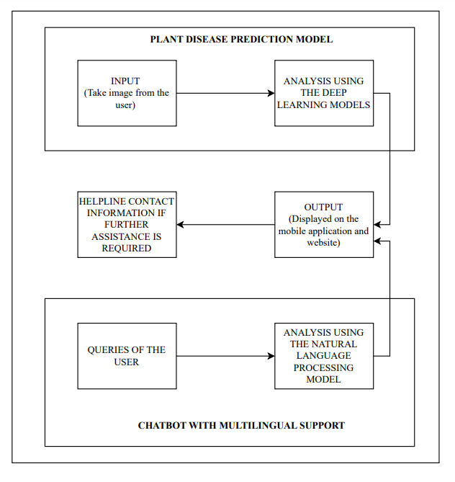
Block Diagram

Slide 15
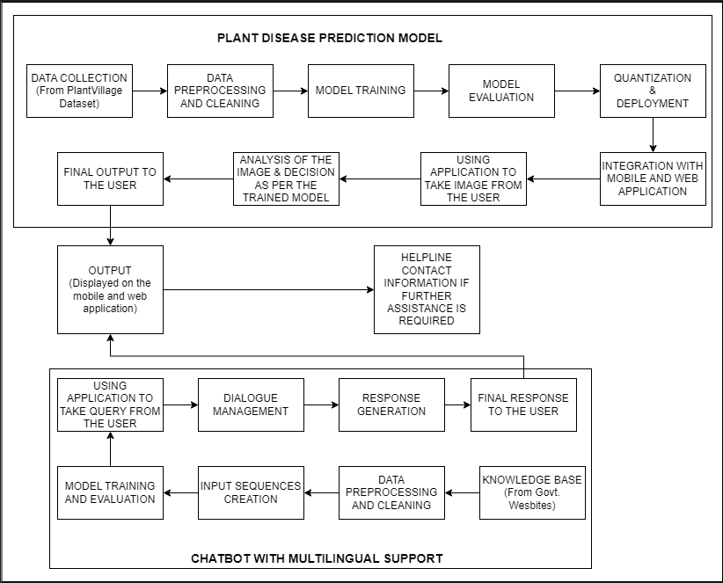
Modular Diagram

Slide 16
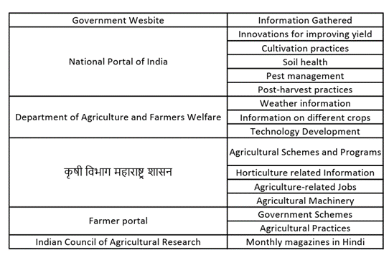
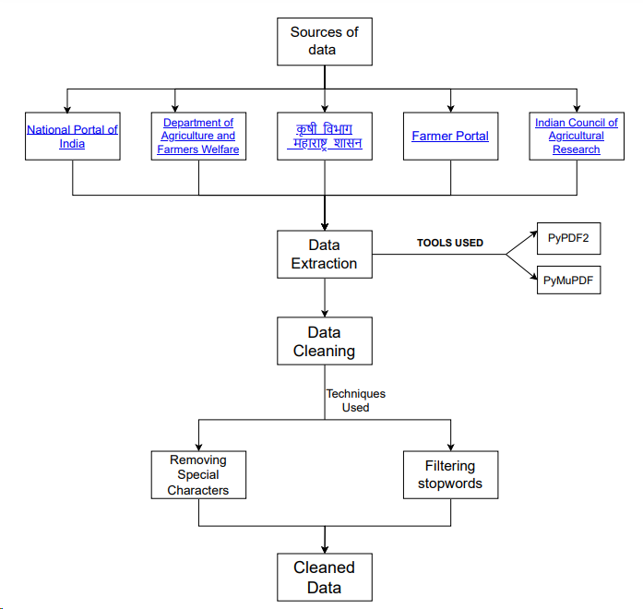
Dataset (for chatbot)

Slide 17
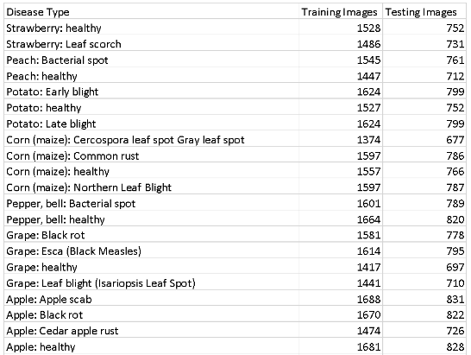
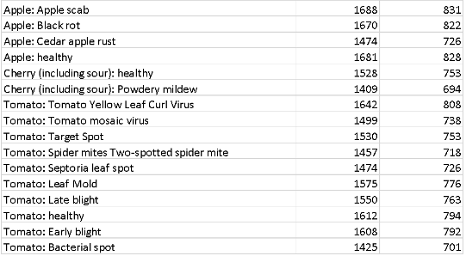
Dataset (for disease prediction)

Slide 18
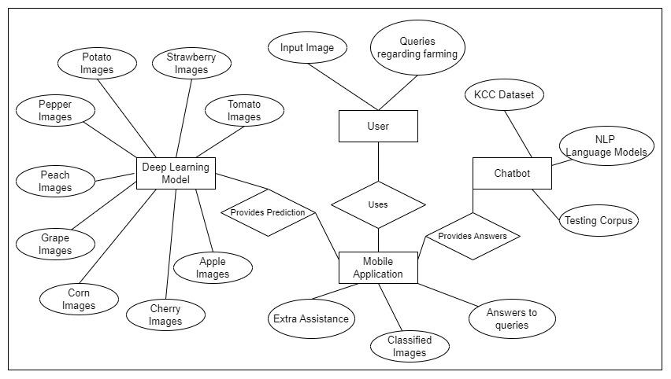
ER Diagram

Slide 19
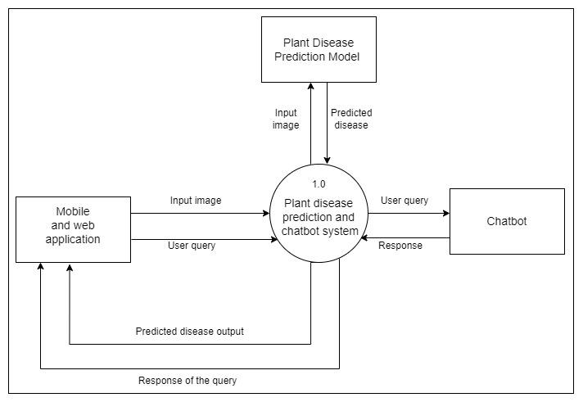
DFD Level 0

Slide 20
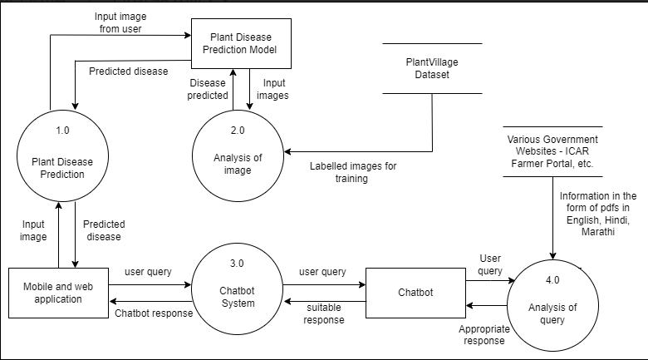
DFD Level 1

Slide 21
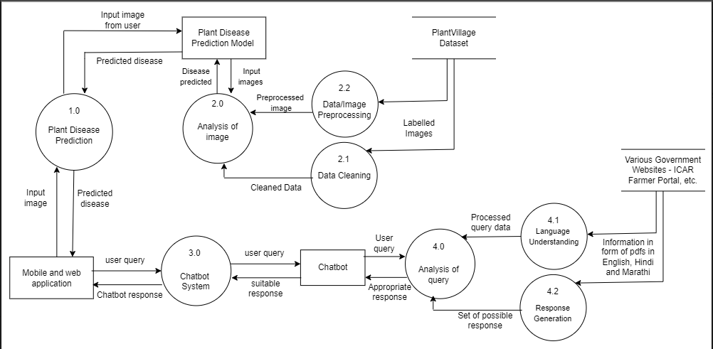
DFD Level 2

Slide 22
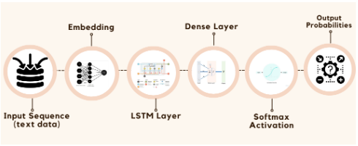
Chatbot Model with Neural Network Layers

Slide 23
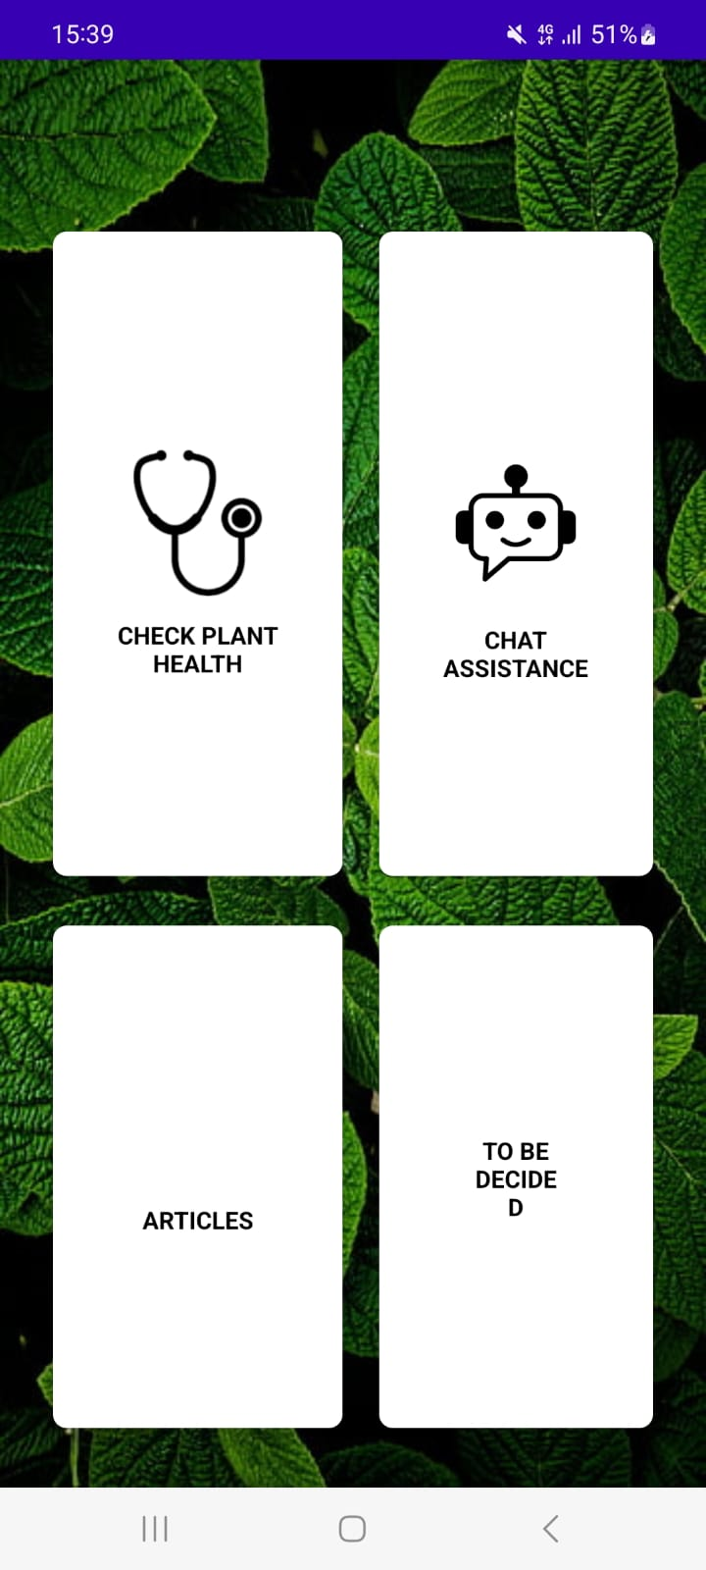
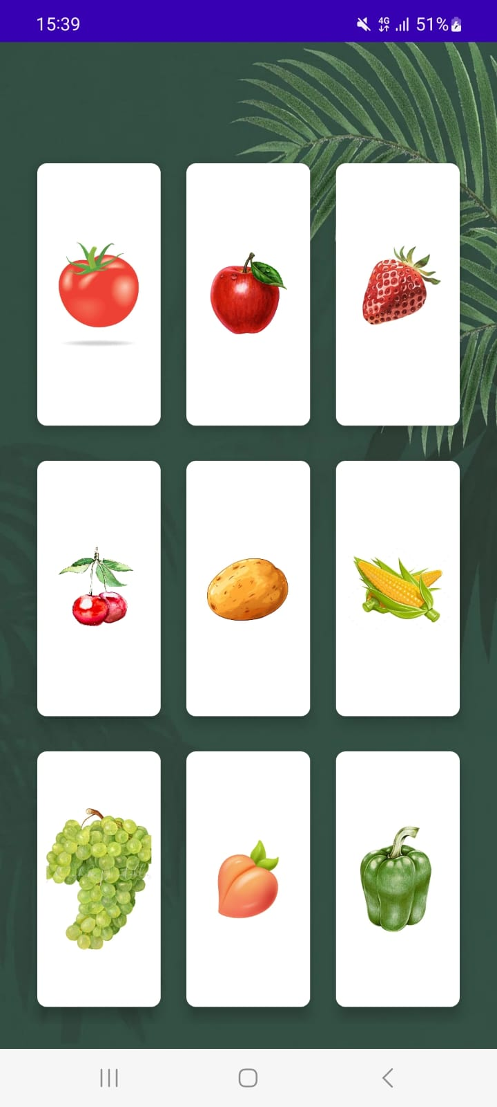
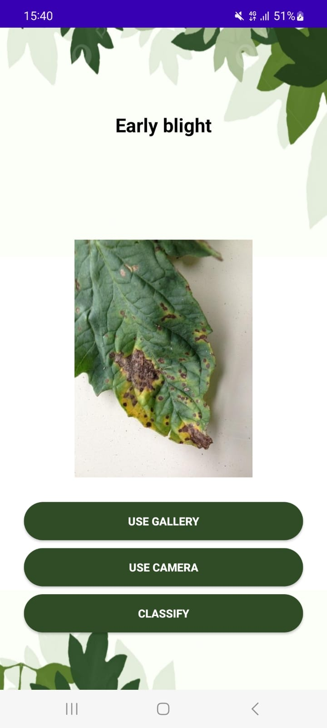
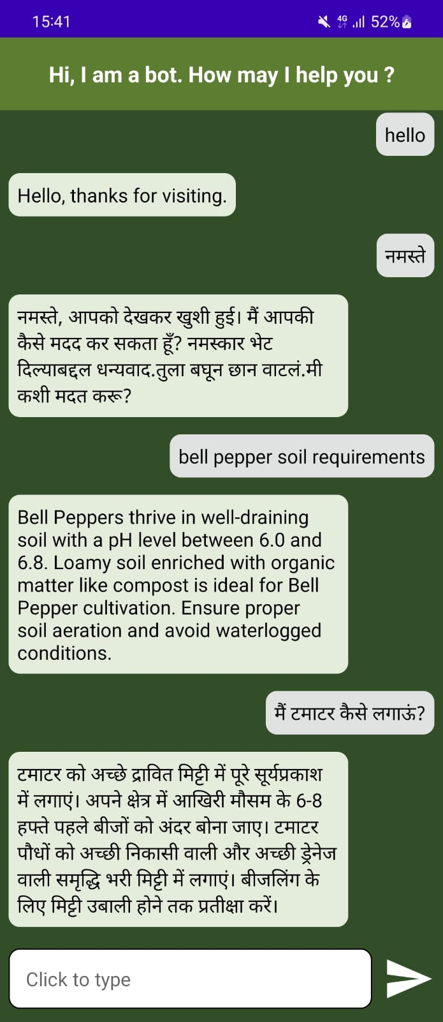
Glimpse of our Android App

Slide 24
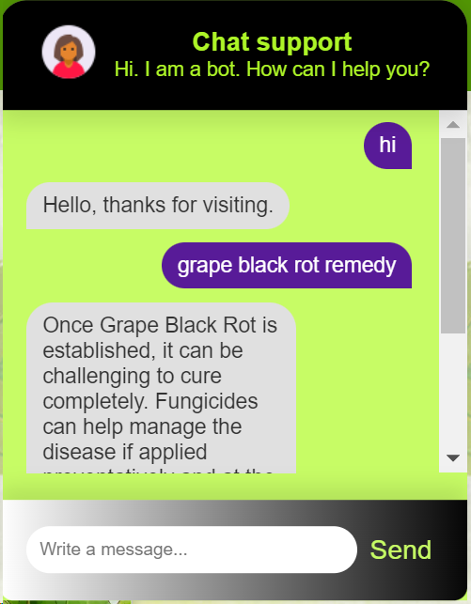
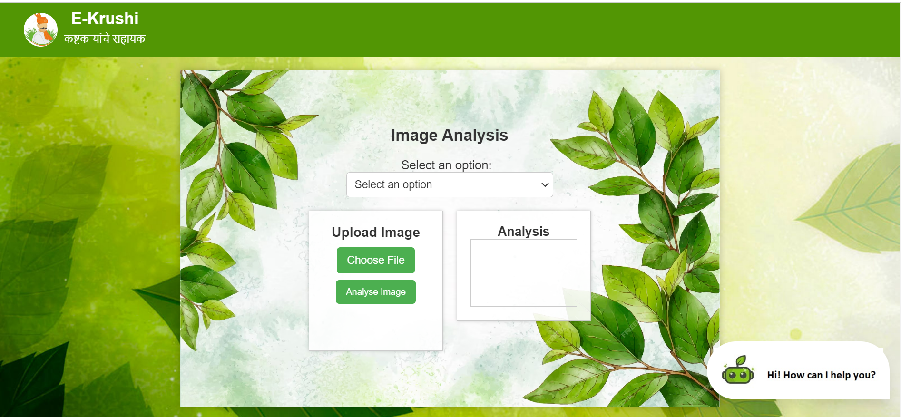
Glimpse of our website

Slide 25
Next Work Plan
To begin with the Chatbot implementation, focus will primarily be on Marathi and Hindi and later the scope will be broadened to different state languages.
Extra Features such as information regarding the price and demand of certain crops in the available markets will be provided.
Quick access to various government schemes and facilities available for the farmers will be provided.
The disease predicting model will be expanded to more species of plants and other types of vegetations.

Slide 26
Conclusion
The proposed project aims to address the pressing issue of plant diseases and their detrimental impact on farmers in India.
By leveraging deep learning tools and natural language processing techniques, the system endeavors to provide quick and accurate analysis of plant health based on leaf images, assisting farmers in combating diseases and preventing losses.
The incorporation of regional languages, starting with Marathi and Hindi, demonstrates a commitment to catering to the vernacular audience and ensuring accessibility for farmers across diverse linguistic backgrounds.
The implementation of a user-friendly website and android application with a multilingual chatbot further enhances the platform's usability and effectiveness.
Overall, this project's objective is to provide better agricultural assistance to farmers in their regional languages, significantly contributing to reducing losses caused by disease proliferation and empowering farmers with vital information for improved crop management.

Slide 27
References
[1] P. Y. Niranjan, V. S. Rajpurohit and R. Malgi, "A Survey on Chat-Bot system for Agriculture Domain," 2019 1st International Conference on Advances in Information Technology (ICAIT), Chikmagalur, India, 2019, pp. 99-103, doi: 10.1109/ICAIT47043.2019.8987429.
[2] D. Sawant, A. Jaiswal, J. Singh and P. Shah, "AgriBot - An intelligent interactive interface to assist farmers in agricultural activities," 2019 IEEE Bombay Section Signature Conference (IBSSC), Mumbai, India, 2019, pp. 1-6, doi: 10.1109/IBSSC47189.2019.8973066.
[3] U. Kiruthika, S. K. S. Raja, V. Balaji and C. J. Raman, "E-Agriculture for Direct Marketing of Food Crops Using Chatbots," 2020 International Conference on Power, Energy, Control and Transmission Systems (ICPECTS), Chennai, India, 2020, pp. 1-4, doi: 10.1109/ICPECTS49113.2020.9337024.
[4] S. V. Militante, B. D. Gerardo and N. V. Dionisio, "Plant Leaf Detection and Disease Recognition using Deep Learning," 2019 IEEE Eurasia Conference on IOT, Communication and Engineering (ECICE), Yunlin, Taiwan, 2019, pp. 579-582, doi: 10.1109/ECICE47484.2019.8942686.

Slide 28
References
[5] H. Andrianto, Suhardi, A. Faizal and F. Armandika, "Smartphone Application for Deep Learning-Based Rice Plant Disease Detection," 2020 International Conference on Information Technology Systems and Innovation (ICITSI), Bandung, Indonesia, 2020, pp. 387-392, doi: 10.1109/ICITSI50517.2020.9264942.
[6] N. Saranya, L. Pavithra, N. Kanthimathi, B. Ragavi and P. Sandhiyadevi, "Detection of Banana Leaf and Fruit Diseases Using Neural Networks," 2020 Second International Conference on Inventive Research in Computing Applications (ICIRCA), Coimbatore, India, 2020, pp. 493-499, doi: 10.1109/ICIRCA48905.2020.9183006.
[7] R. D. Devi, S. A. Nandhini, R. Hemalatha and S. Radha, "IoT Enabled Efficient Detection and Classification of Plant Diseases for Agricultural Applications," 2019 International Conference on Wireless Communications Signal Processing and Networking (WiSPNET), Chennai, India, 2019, pp. 447-451, doi: 10.1109/WiSPNET45539.2019.9032727.
[8] Kirti and N. Rajpal, "Black Rot Disease Detection in Grape Plant (Vitis vinifera) Using Colour Based Segmentation & Machine Learning," 2020 2nd International Conference on Advances in Computing, Communication Control and Networking (ICACCCN), Greater Noida, India, 2020, pp. 976-979, doi: 10.1109/ICACCCN51052.2020.9362812.

Slide 29
References
[9] J. S. H. Al-bayati and B. B. Üstündağ, "Artificial Intelligence in Smart Agriculture: Modified Evolutionary Optimization Approach for Plant Disease Identification," 2020 4th International Symposium on Multidisciplinary Studies and Innovative Technologies (ISMSIT), Istanbul, Turkey, 2020, pp. 1-6, doi: 10.1109/ISMSIT50672.2020.9255323.
[10] M. A. Rahman, M. M. Islam, G. M. Shahir Mahdee and M. W. Ul Kabir, "Improved Segmentation Approach for Plant Disease Detection," 2019 1st International Conference on Advances in Science, Engineering and Robotics Technology (ICASERT), Dhaka, Bangladesh, 2019, pp. 1-5, doi: 10.1109/ICASERT.2019.8934895.
[11] B. S. Kusumo, A. Heryana, O. Mahendra and H. F. Pardede, "Machine Learning-based for Automatic Detection of Corn-Plant Diseases Using Image Processing," 2018 International Conference on Computer, Control, Informatics and its Applications (IC3INA), Tangerang, Indonesia, 2018, pp. 93-97, doi: 10.1109/IC3INA.2018.8629507.
[12] S. Y. Yadhav, T. Senthilkumar, S. Jayanthy and J. J. A. Kovilpillai, "Plant Disease Detection and Classification using CNN Model with Optimized Activation Function," 2020 International Conference on Electronics and Sustainable Communication Systems (ICESC).

Slide 30
References
[13] L. Li, S. Zhang and B. Wang, "Plant Disease Detection and Classification by Deep Learning—A Review," in IEEE Access, vol. 9, pp. 56683-56698, 2021, doi: 10.1109/ACCESS.2021.3069646.
[14] T. Maginga, J. Nsenga, P. Bakunzibake and E. Masabo, "Smallholder farmer-centric integration of IoT and Chatbot for early Maize diseases detection and management in pre-visual symptoms phase," 2022 IEEE Global Humanitarian Technology Conference (GHTC), Santa Clara, CA, USA, 2022, pp. 369-372, doi: 10.1109/GHTC55712.2022.9911047.
[15] V. Rajesh Kumar, K. Pradeepan, S. Praveen, M. Rohith and V. Vasantha Kumar, "Identification of Plant Diseases Using Image Processing and Image Recognition," 2021 International Conference on System, Computation, Automation and Networking (ICSCAN), Puducherry, India, 2021, pp. 1-4, doi: 10.1109/ICSCAN53069.2021.9526493.
[16] Deepa, R. N and C. Shetty, "A Machine Learning Technique for Identification of Plant Diseases in Leaves," 2021 6th International Conference on Inventive Computation Technologies (ICICT), Coimbatore, India, 2021, pp. 481-484

